Slide 1
Powder Coating Oven
Verina Abdelmesih
Desiree Dee
Amber Malenowsky
Hussain Alismail

Slide 2
Project Description
Goal ​
Design a mobile powder coating oven that can be used by all programs​
Work with the bumper capstone team​
Powered by a propane fueled torpedo heater​
Controlled using a PID control system​
Stakeholder​
The Renewable Energy Lab​
Client​
Carson Pete​
The powder coating machine will be housed in the renewable energy lab​
Desiree 4/26/23

Slide 3
Curing Technique
Prep/Pretreatment
Use Super Degreaser to clean the part
Use an Epoxy base coat and cure for longer than powder curing time
Blast/Sand down the object to remove impurities
Use AllPrep Iron Phosphate
Application
Ground part using a wire
Note Faraday areas
Preheat part with oven to improve adhesion
Hussain 4/26/23

Slide 4
Design Description
High Temp. Fan
Trolly System
Oven Body
Oven Body
Trolly System
Torpedo Heater
PID System
High Temp. Fan
Exhaust Fan
PID Box
Exhaust Fan
Torpedo Heater
Hussain 4/26/23
Notes:
Describe the current state of your design and CAD model.
• Provide a high-quality image of your design with subsystems labeled on the image.
• Provide a bullet list describing how your design functions or the implementation details

Slide 5
Design Requirements (Amber)
Propane Fueled heater
High Temperature: 500°F
Control System
Safety: Emergency Shut off
Amber 4/26/23

Slide 6
Structural Analysis
Trolly Weight
Roof Weight
Equations:
$σ= \frac{W}{A}$
$τ= \frac{V}{A}$
$FS= \frac{σ_{Ultimate}}{σ_{Design}}$
Required F.S. = 2
Side Weight
Back Weight
Weight of Pumper
Reaction Forces
Reaction Forces
Hussain 4/26/23

Slide 7
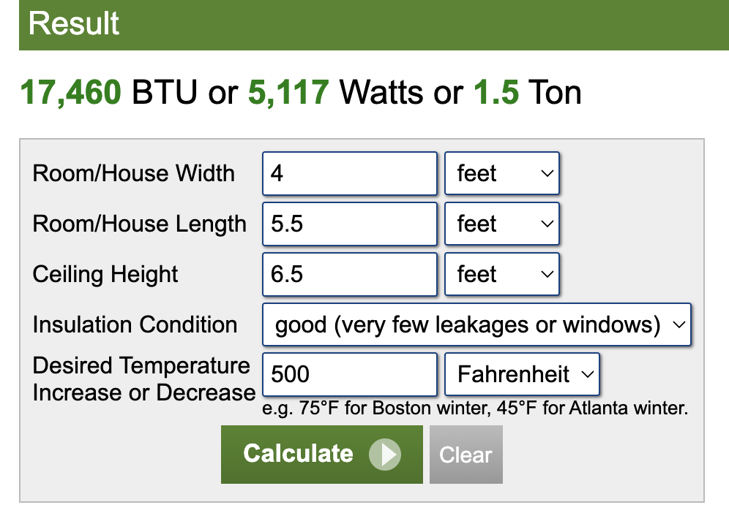
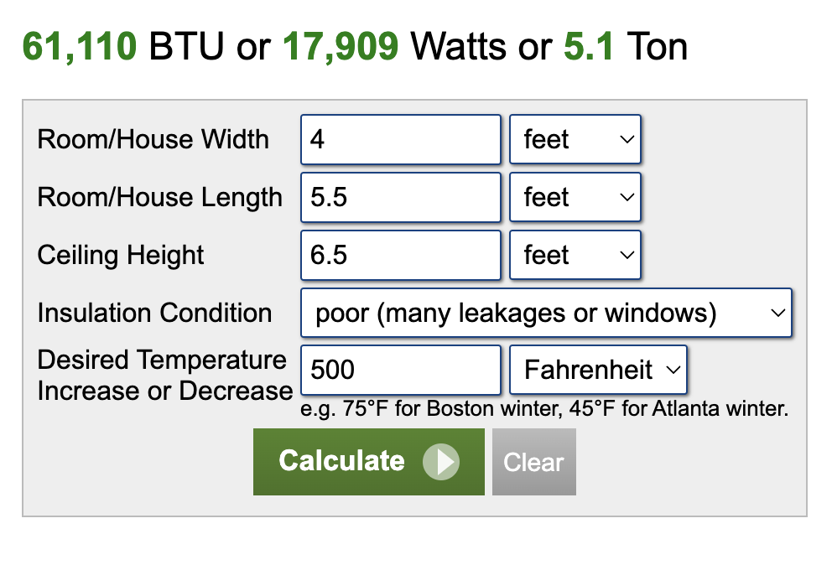
Fuel Component Analysis
Amber 4/26/23

Slide 8
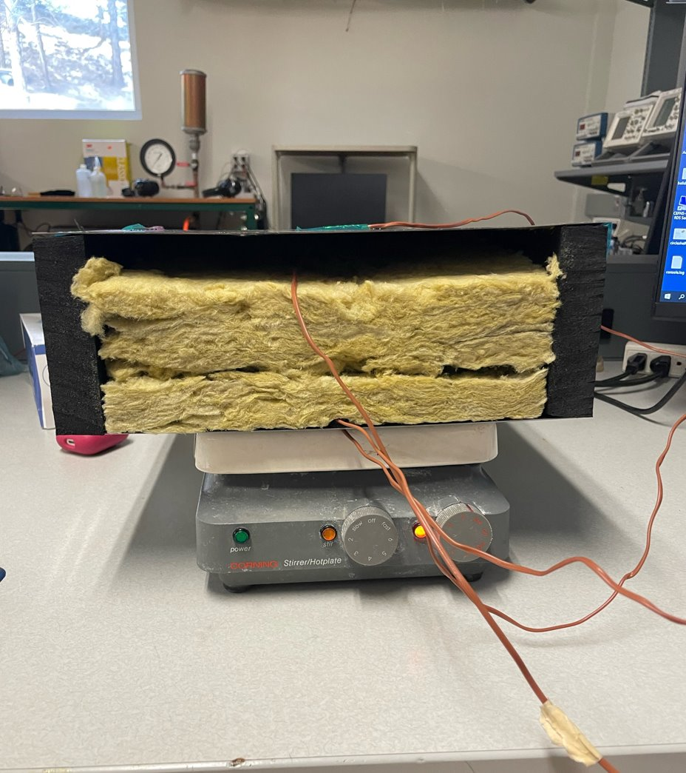
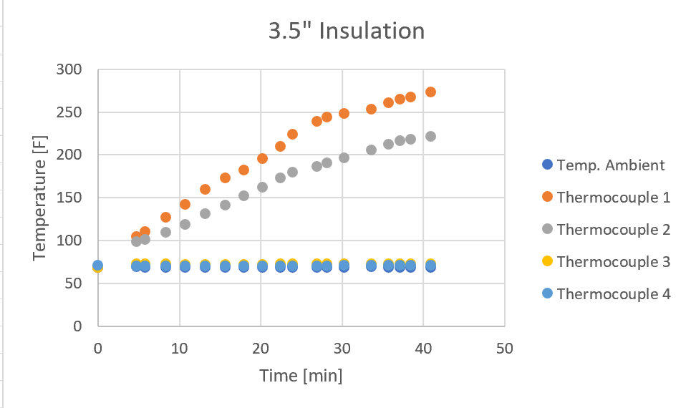
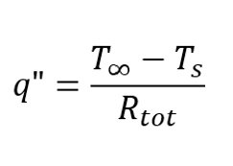
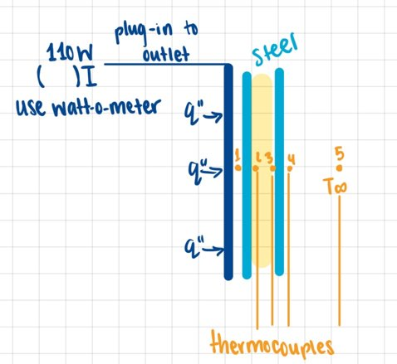
Heat Transfer Analysis
Desiree 4/26/23

Slide 9
Heat Ventilation and Circulation
Verina 4/26/23

Slide 10
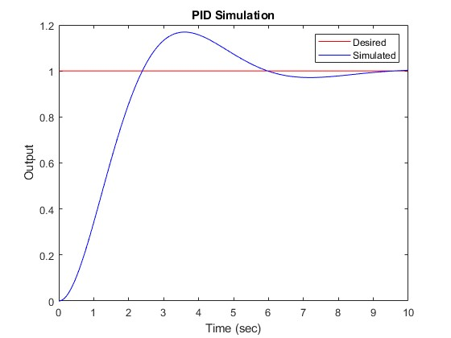
Control System Analysis
The pid controller model object can represent parallel-form PID controllers in continuous time or discrete time.
Kp : proportional gain
Ki : Integral gain
Kd : Derivative gain
T_{f} : first-order derivative filter time constant
IF(z) : integrator method for computing integral in discrete-time controller.
DF(z) : integrator method for computing derivative filter in discrete-time controller.
Figure 1: Discrete Time formula [1]
Verina 4/26/23

Slide 11
Design Validation
Desiree 4/26/23

Slide 12
Prototyping and Testing Procedure
Equipment
20 gallon air compression
Hammer
Toaster Oven
Aluminum, Steel, and Tin Blocks
High Temperature Vinyl
Verina 4/26/23

Slide 13
Prototyping and Testing Procedure
Tests
Adhesion
This will be to test whether the Epoxy primer is necessary.
Abrasion
The test will consist of scraping powder coated items and leaving them in vinegar/saltwater overnight to test powder quality.
Impact
The test will consist of hitting the material with a hammer.
Curing
Test what type of vinyl can be used to create designs
Strength
The test will consist of bending the material to test the durability of the powder.
Verina 4/26/23

Slide 14
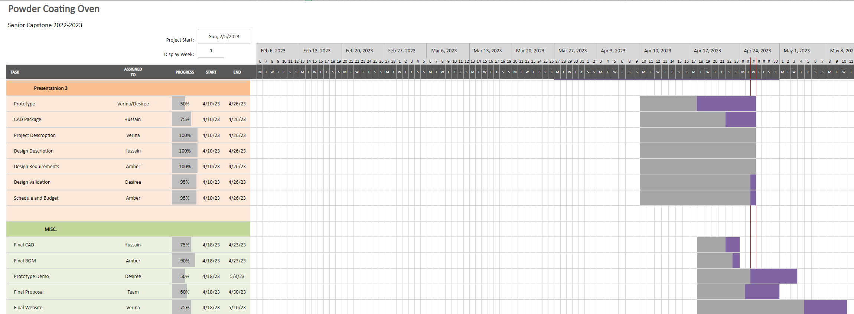
Schedule
Amber 4/26/23

Slide 15
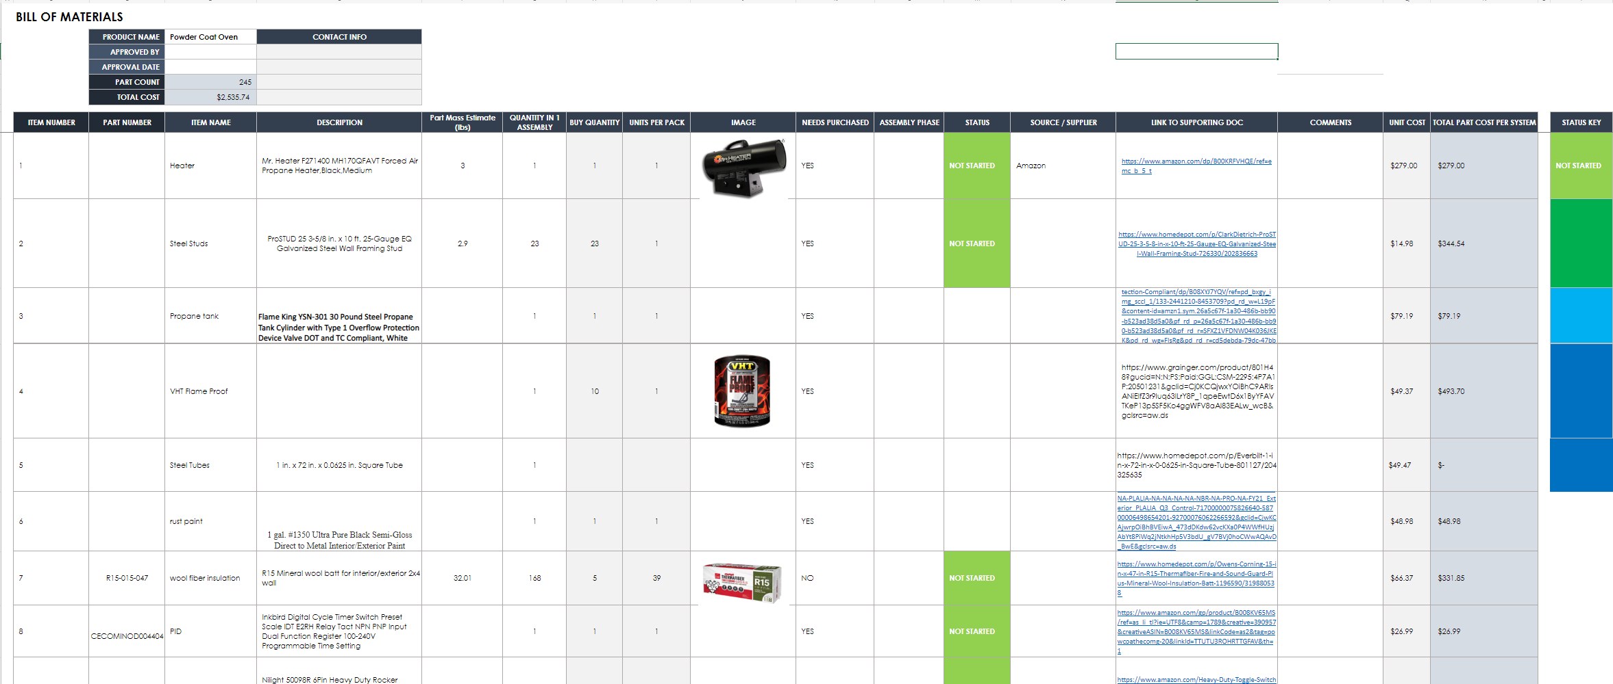
Budget (Amber)
Total Cost: 2,535.74
Amber 4/26/23

Slide 16
References
[1] “Sys,” PID controller in parallel form - MATLAB. [Online]. Available: https://www.mathworks.com/help/control/ref/pid.html. [Accessed: 26-Apr-2023].
[2] “170,000 BTU Forced Air Propane Heater.” https://www.mrheater.com/catalog/product/view/id/1250/s/170-000-btu-forced-air-propane-heater/category/99/
[3] “BTU Calculator.” https://www.calculator.net/btu-calculator.html?roomwidth=4&roomwidthunit=feet&roomlength=5.5&roomlengthunit=feet&ceilingheight=6.5&ceilingheightunit=feet&insulation=good&temperature=500&temperatureunit=f&ctype=house&x=0&y=0#housebtu

Slide 17
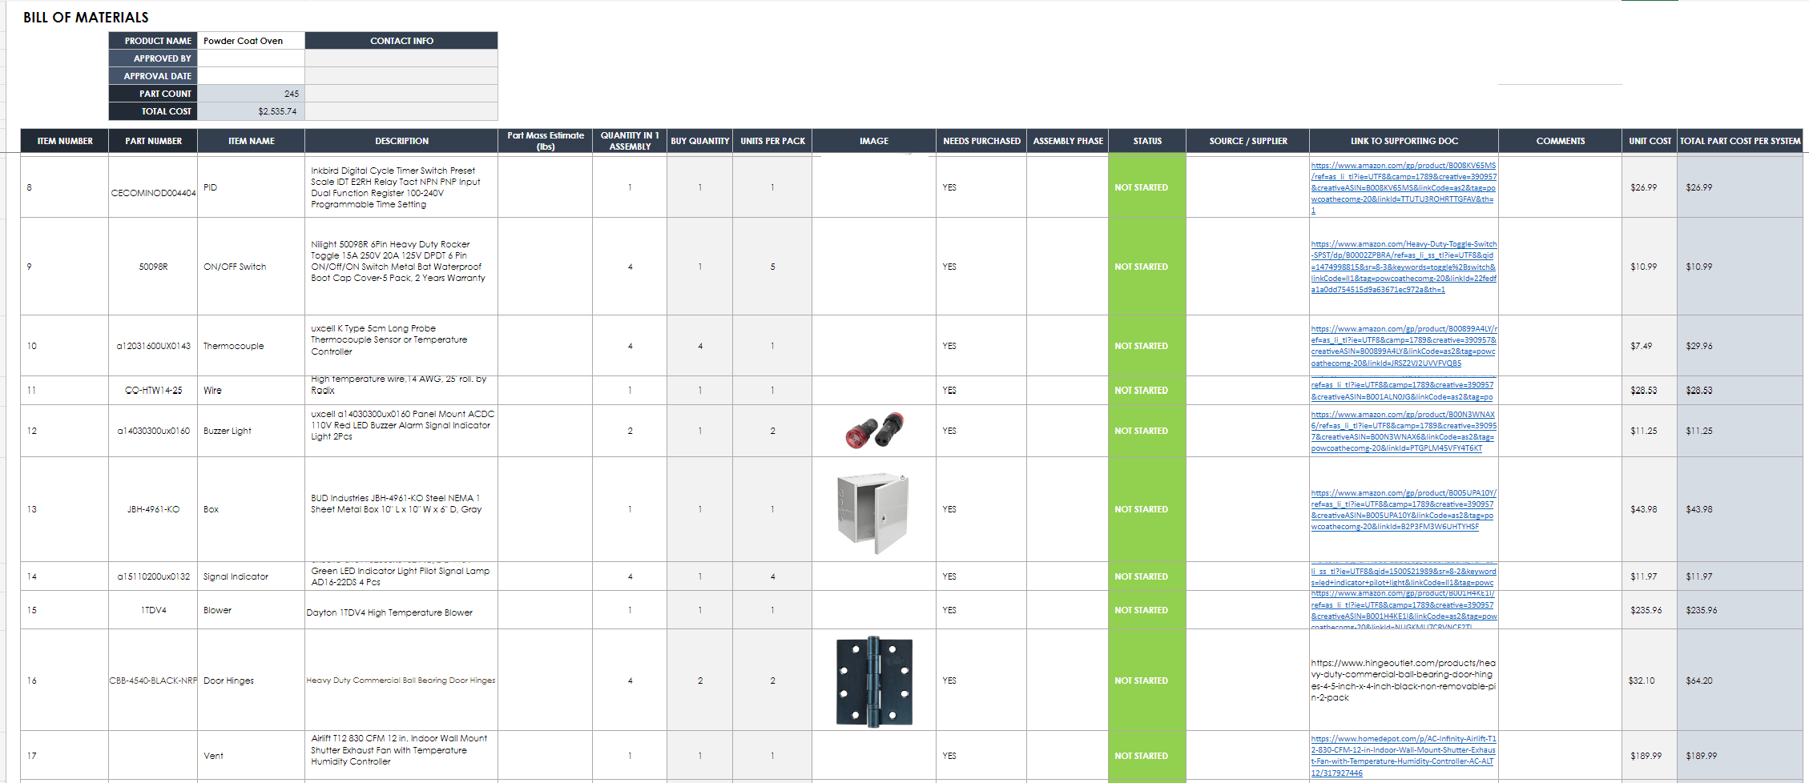
Bill of Materials Extended

Slide 18
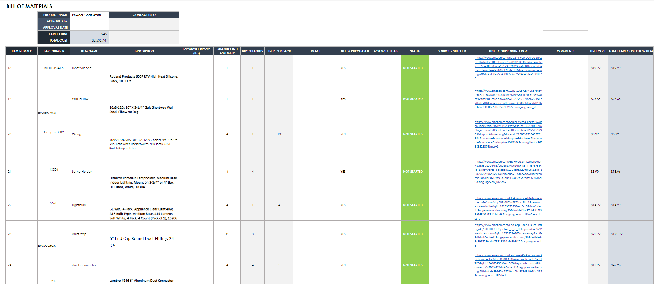
Bill of Materials Extended

Slide 19
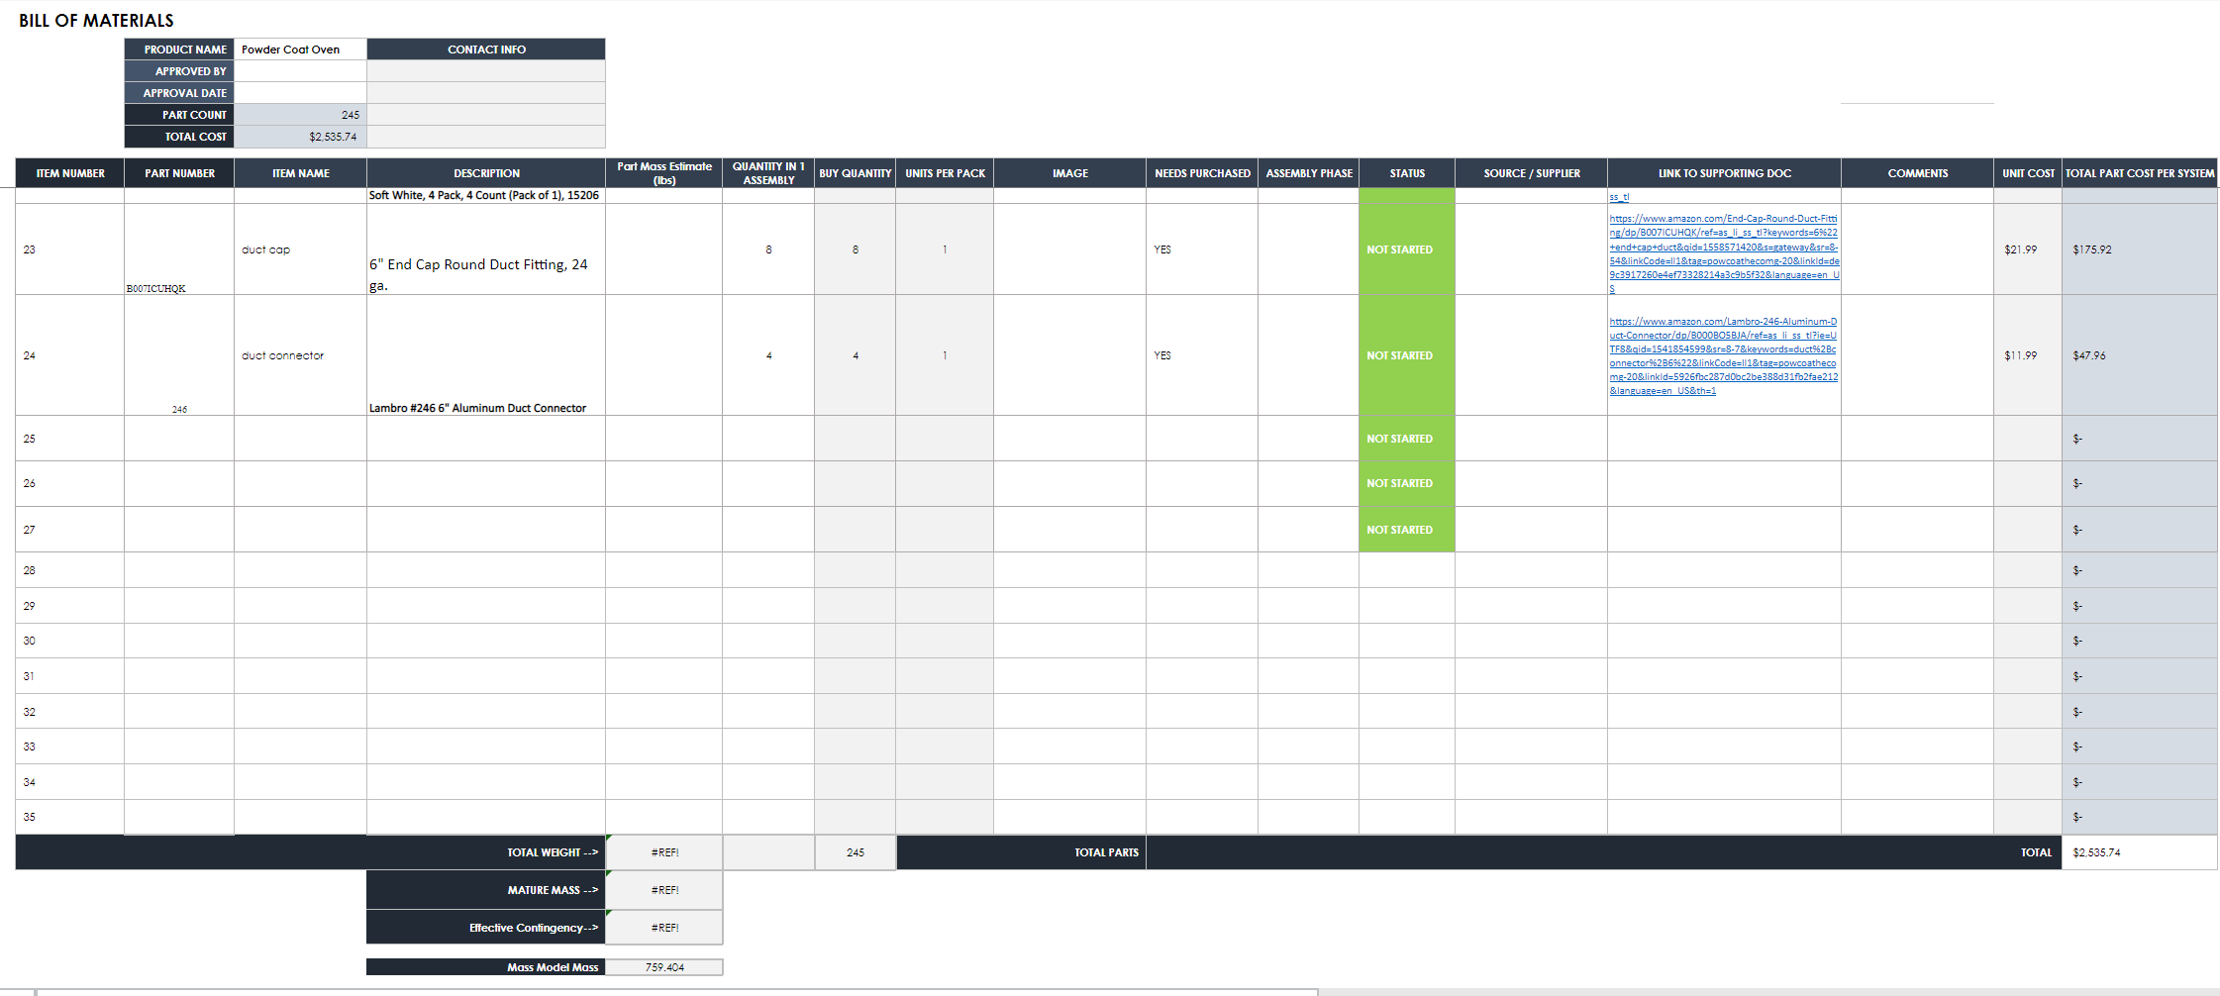
Bill of Materials Extended

